Slide 1
CS 4215: Quantitative Performance Evaluation for Computing ystems
Lydia Y. Chen
y.chen-10@tudelft.nl

Slide 2
Comparison questions?
Q1. You are looking for a computing cloud to host your websites so that the average latency is minimized. Which cloud provider? What kind of VMs? How many VMs?
Q2. You design a (machine learning) algorithm, which has many parameters. How do you set the parameters such that the computing time and the algorithm accuracy are maximized?

Slide 3
Learning objective
You will be able to design experiments which can capture the effects and their integrations
You will be able to analyze the experimental results and assess its significance

Slide 4
Design experiment is about
designing a proper set of experiments for measurement or simulation
developing a model that best describes the data obtained
analyzing the goodness of mode vis errors and variances

Slide 5
Last week

Slide 6
2^{k} Factorial Designs

Slide 7
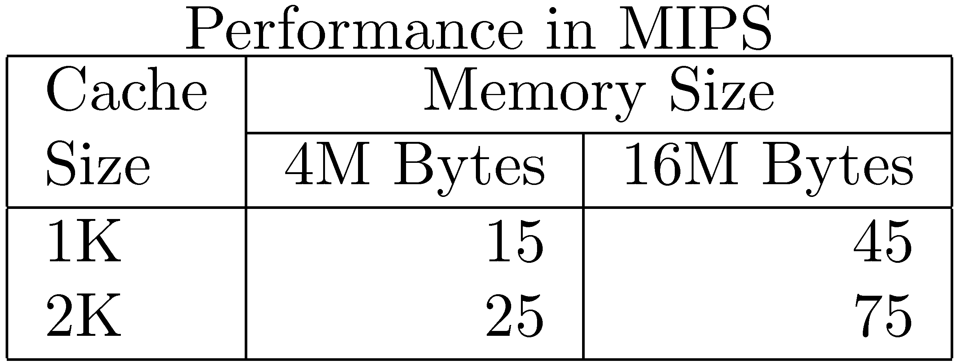
Examples of 2^{k} factor experiment:
What is the MIPS given memory size and cache size? Two levels of memory sizes and two level of cache sizes

Slide 8
2^{k} Factorial Designs
k factors, each at two levels.
Features: easy to analyze. helps in sorting out impact of factors, and good at the beginning of a study.
Valid only if the effect is unidirectional. E.g., memory size, the number of disk drives
Sign Table: specific way of coding levels of factors, a powerful tool to construct small number of experiments for models

Slide 9
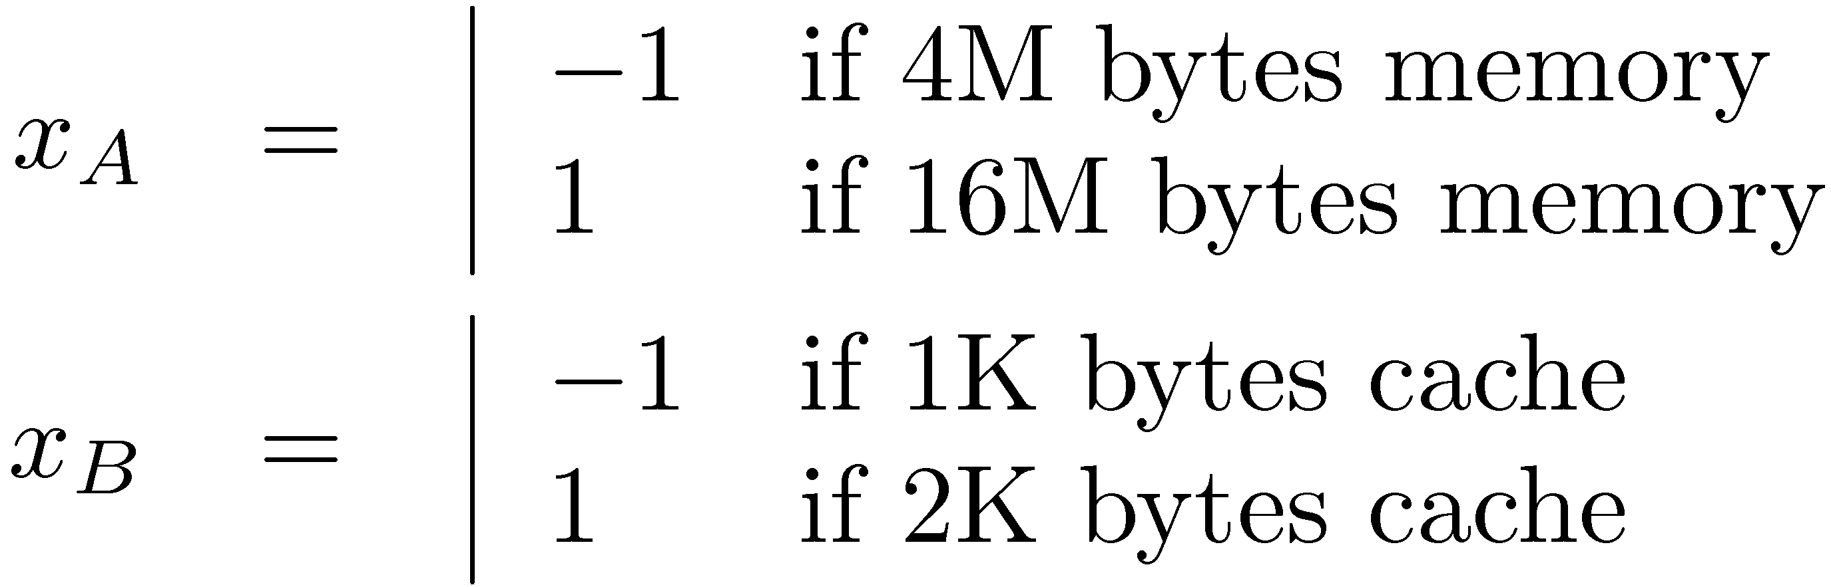
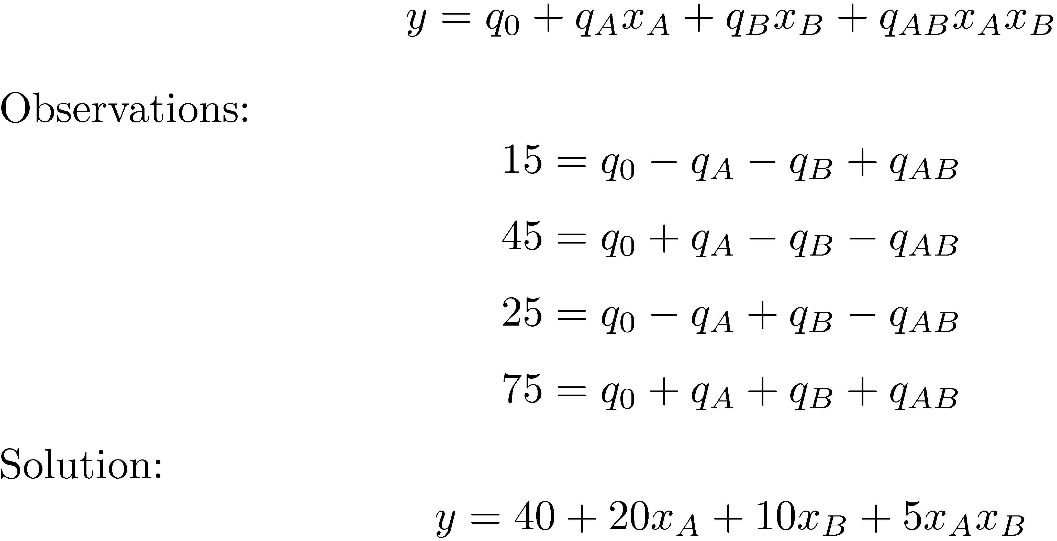
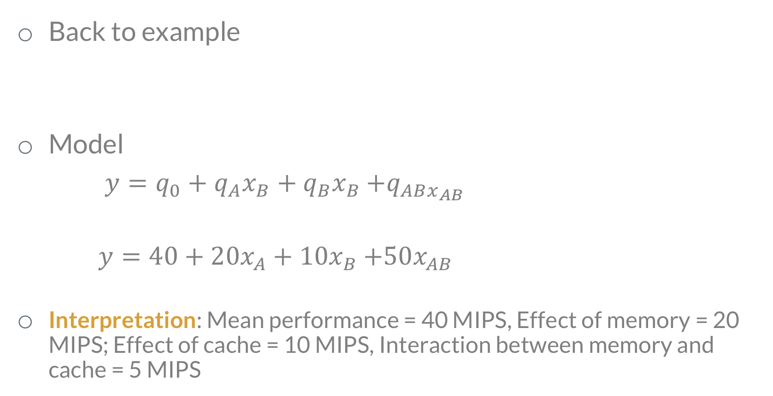
Model : option 1
Back to example
Model
$y=q_{0}+q_{A}x_{B}+q_{B}x_{B}$ $+q_{ABx_{AB}}$
$y=40+20x_{A}+10x_{B}$ $+50x_{AB}$
Interpretation: Mean performance = 40 MIPS, Effect of memory = 20 MIPS; Effect of cache = 10 MIPS, Interaction between memory and cache = 5 MIPS

Slide 10
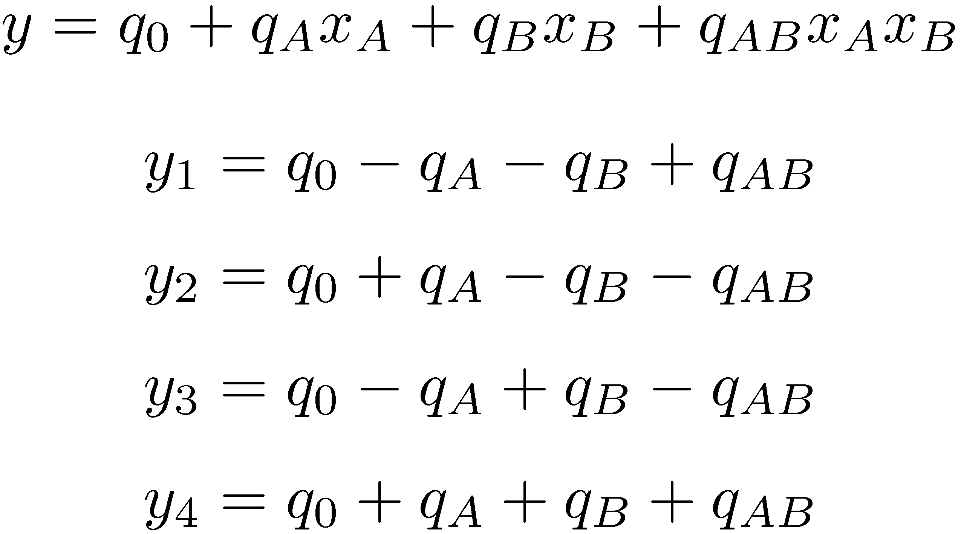
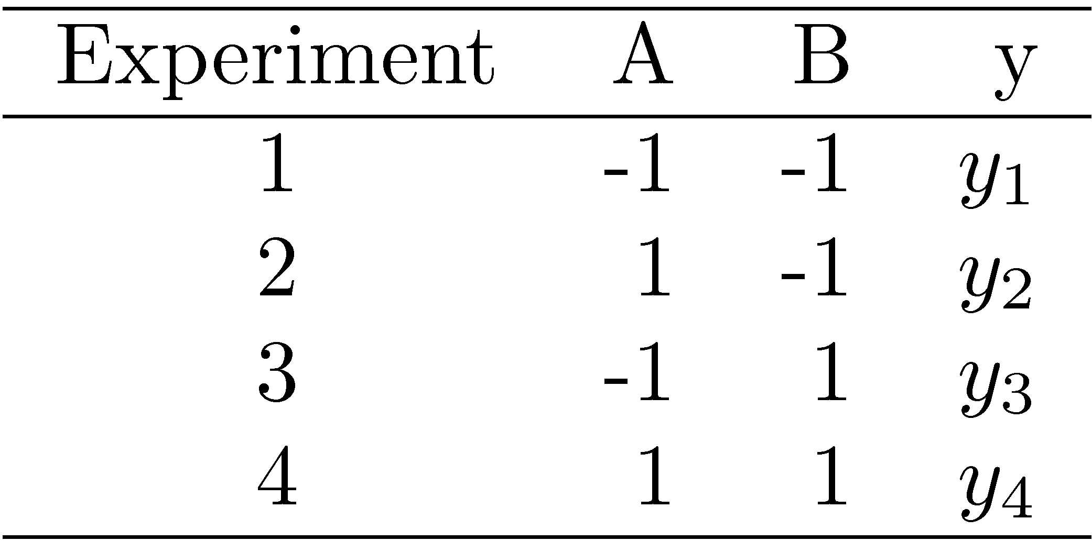
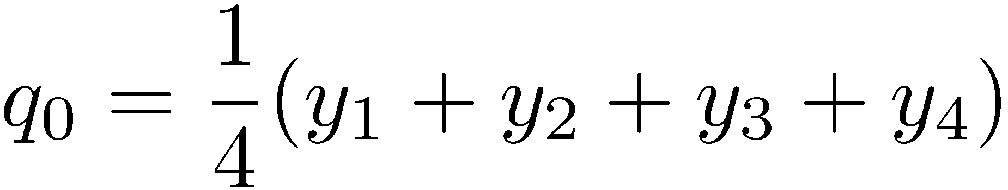
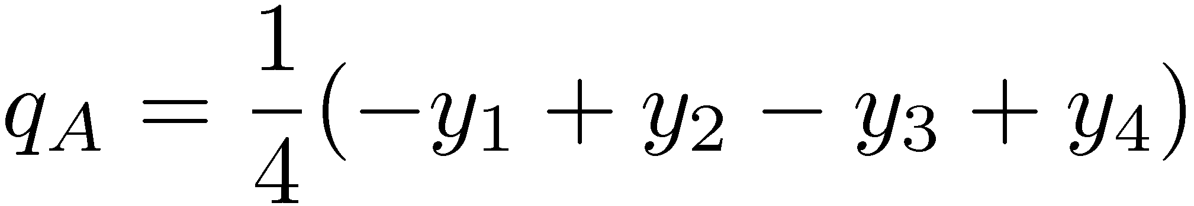
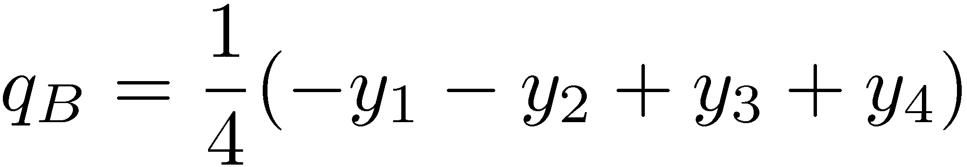
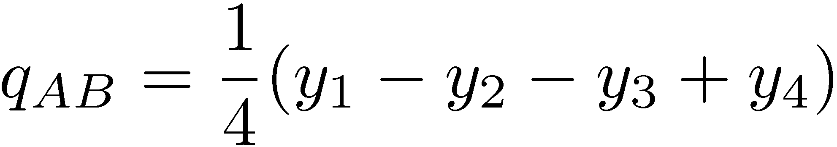
Model: by sign table
Row view
column view

Slide 11
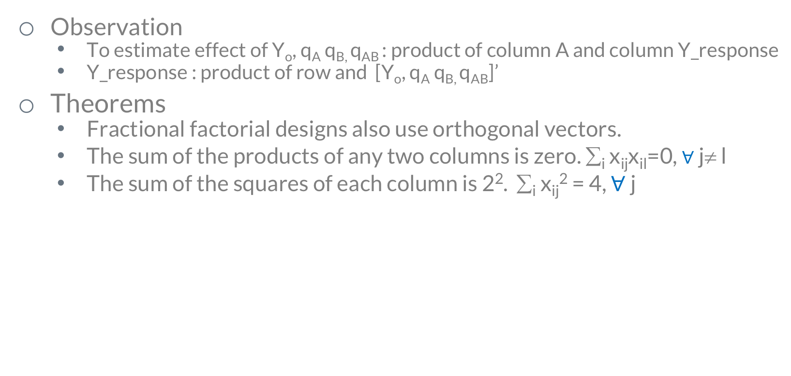
Model: by design table
Fill column Y_o, AB
Exp | Y_{o} (I) | A | B | AB | Y_response
1 |  | 1 | -1 |  | Y₁
2 |  | -1 | -1 |  | Y₂
3 |  | 1 | 1 |  | Y₃
4 |  | -1 | 1 |  | Y₄
Observation
To estimate effect of Y_{o}, q_{A} q_{B,} q_{AB} : product of column A and column Y_response
Y_response : product of row and [Y_{o}, q_{A} q_{B,} q_{AB}]’
Theorems
Fractional factorial designs also use orthogonal vectors.
The sum of the products of any two columns is zero. ∑_{i} x_{ij}x_{il}=0, $∀$j≠ l
The sum of the squares of each column is 2². ∑_{i} x_{ij}² = 4, $∀$ j

Slide 12
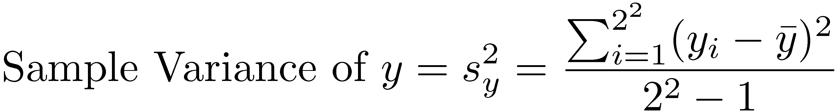
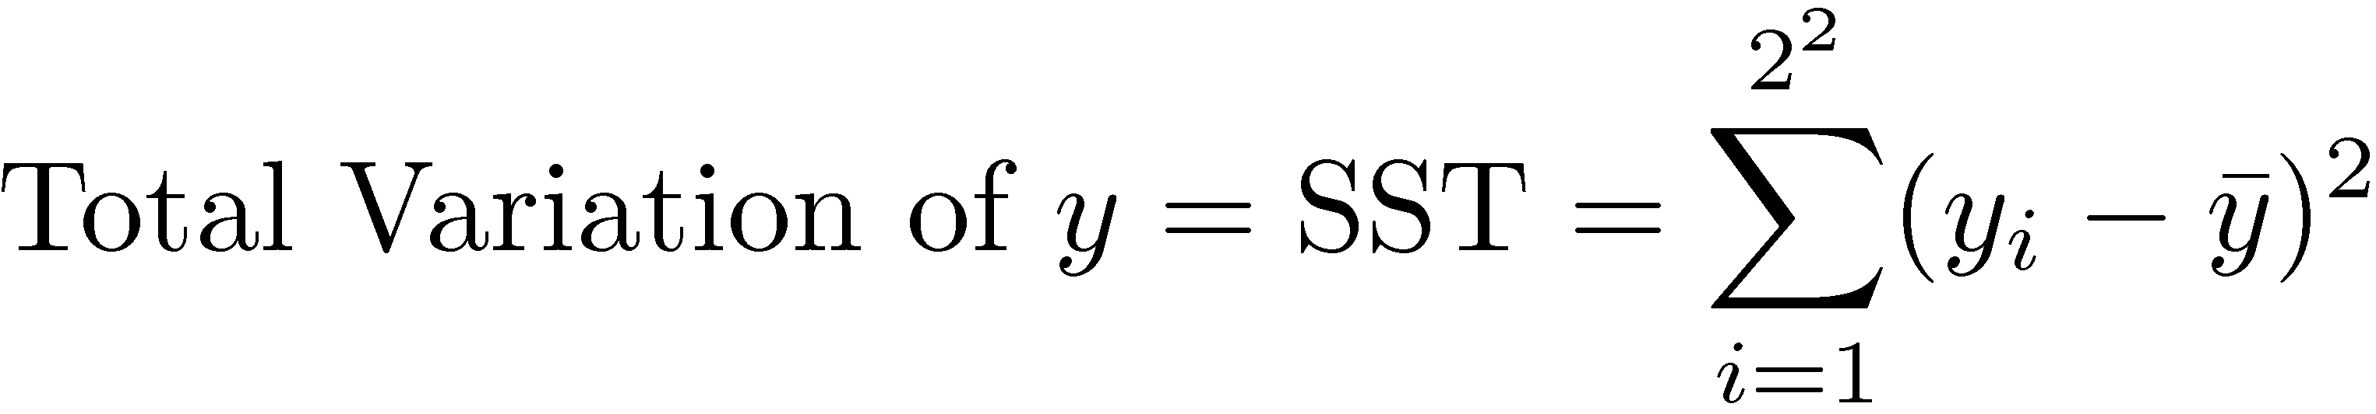
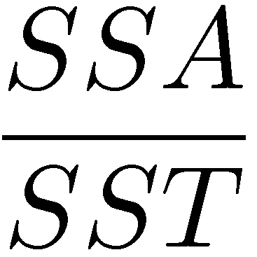
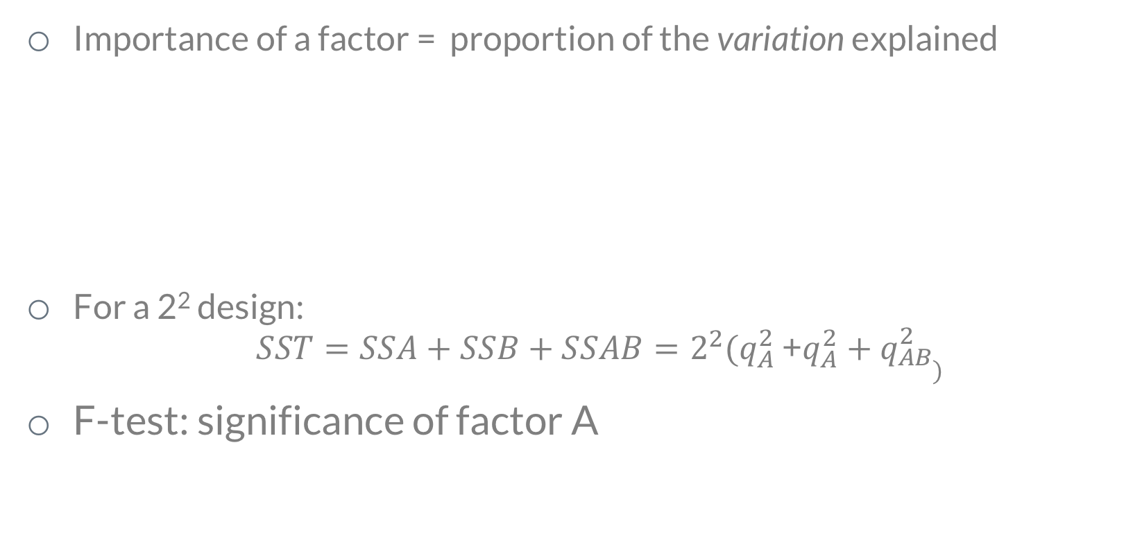
ANOVA
Importance of a factor = proportion of the variation explained
For a 2² design:
$SST=SSA+SSB+SSAB=2^{2}{(q}_{A}^{2}$ +$q_{A}^{2}+q_{\begin{aligned}AB \\ \end{aligned})}^{2}$
F-test: significance of factor A
Variation =! Variance

Slide 13
Computer results
v

Slide 14
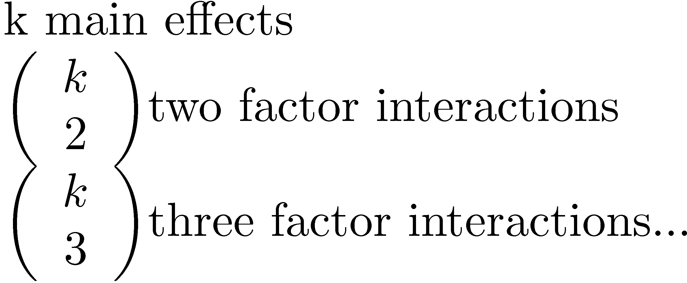
General 2^{k} Factorial Designs
k factors at two levels each.
2^{k} experiments.
2^{k} effects:

Slide 15
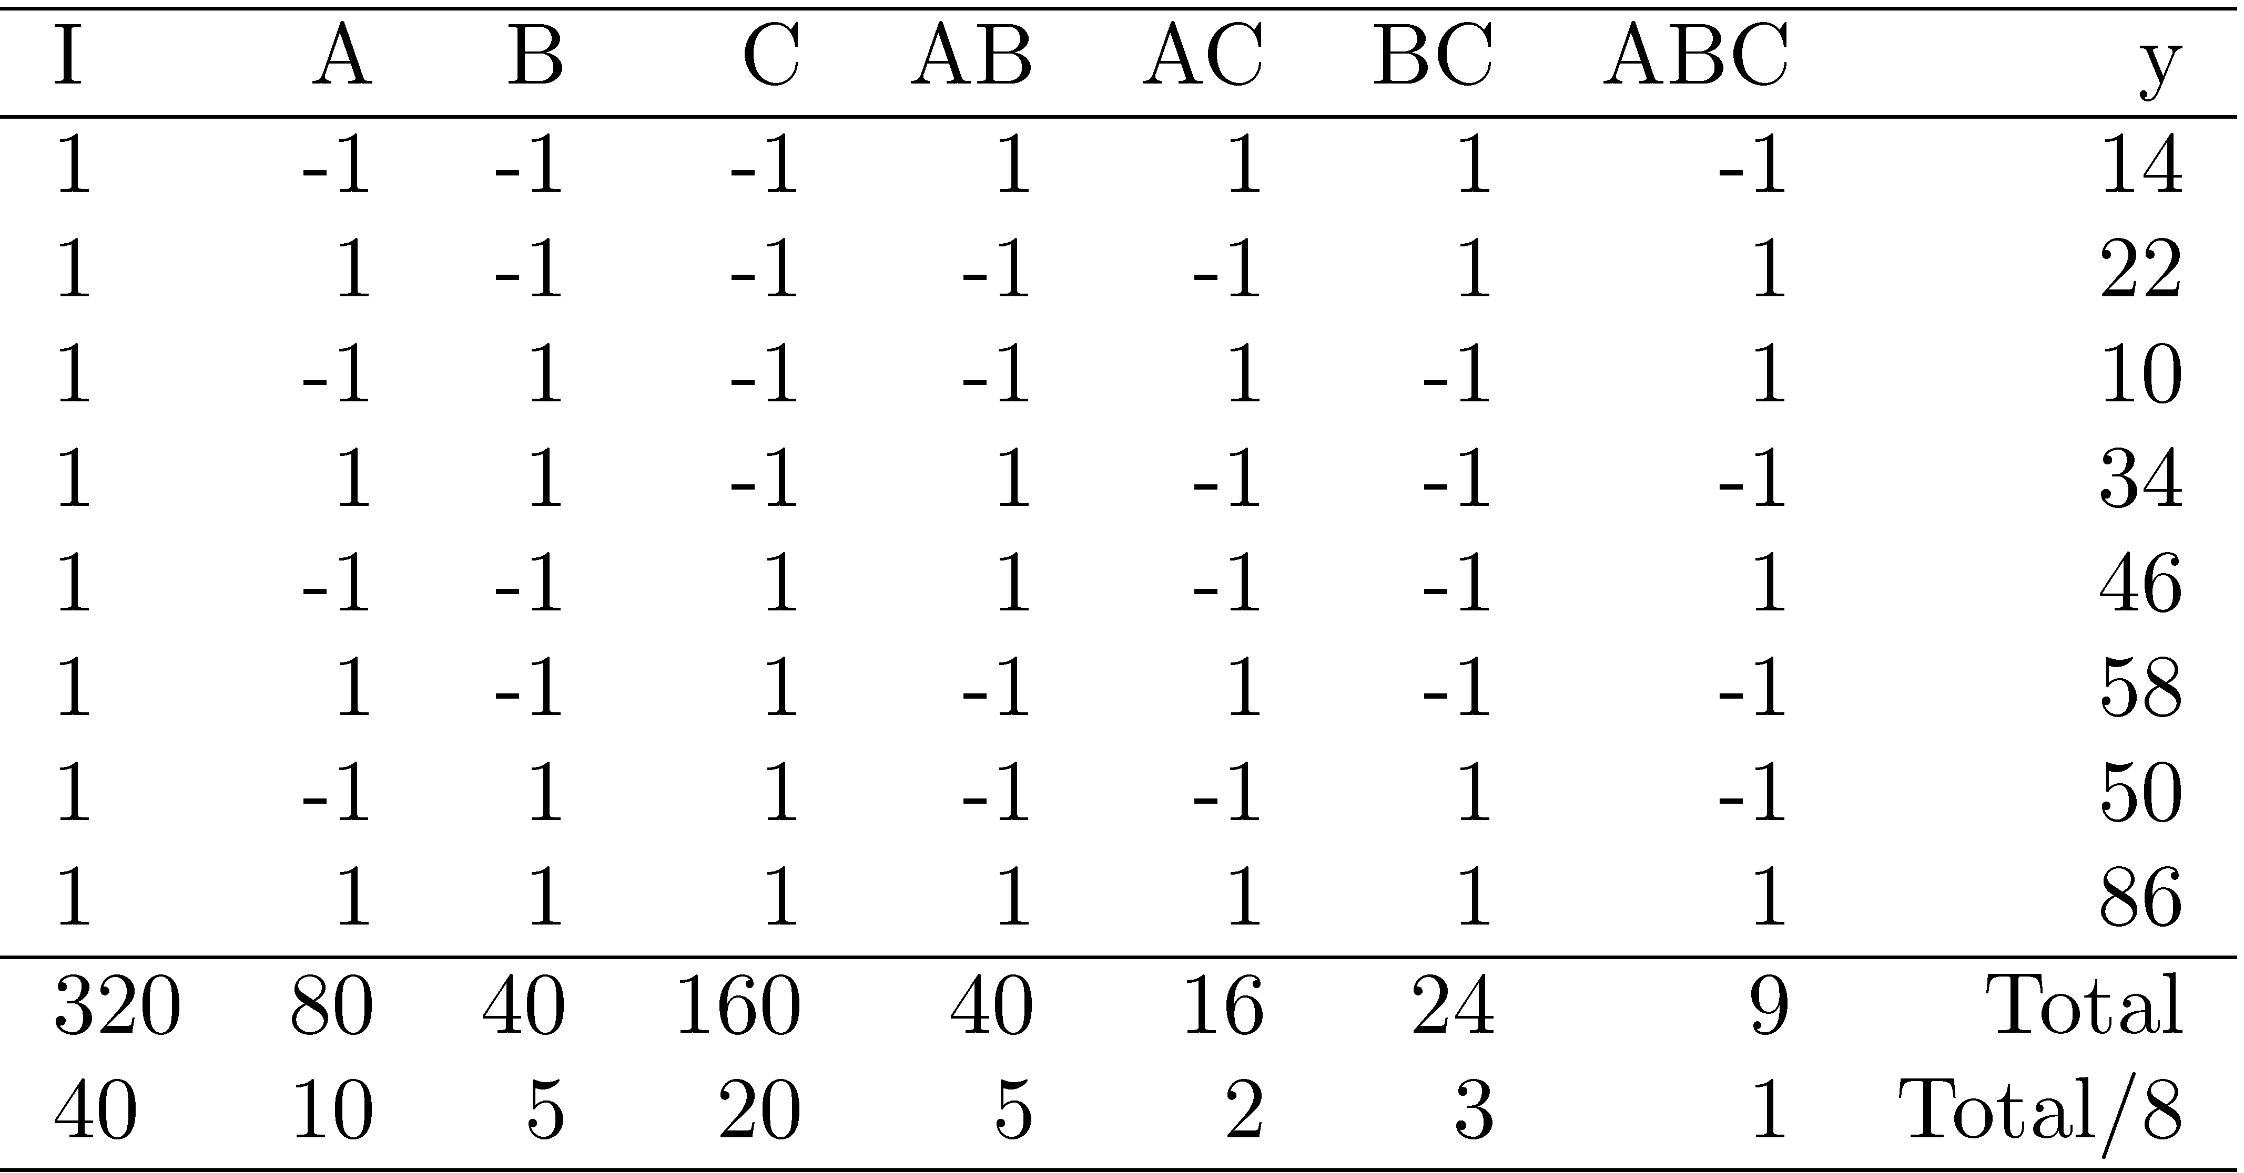
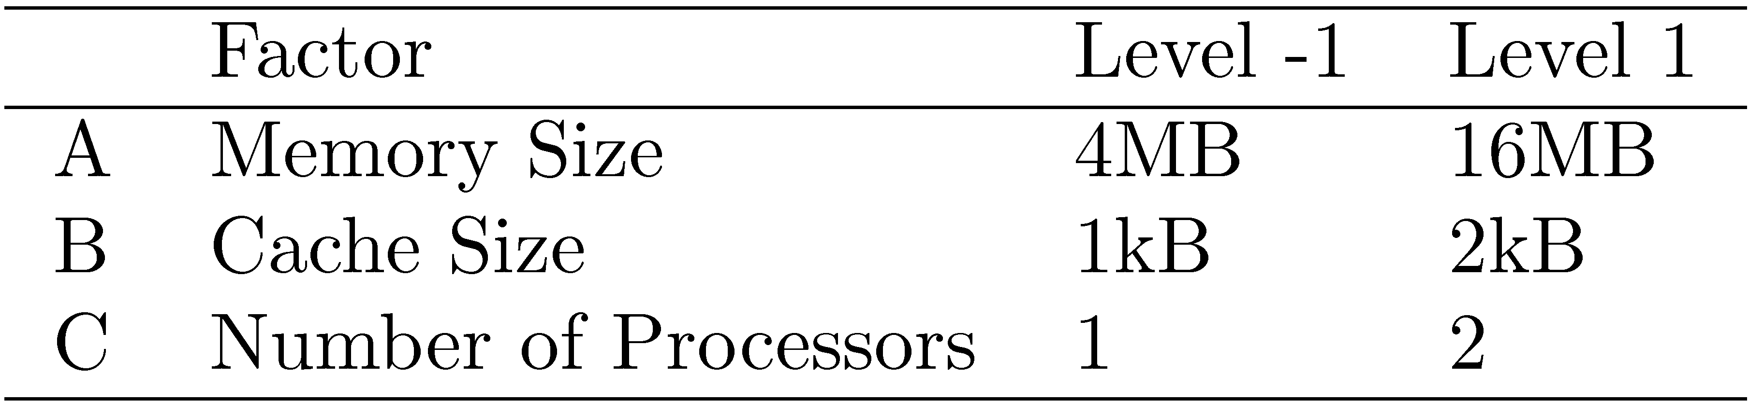
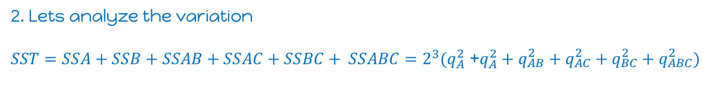
2^{k} Design Example
Three factors in designing a machine:
Cache size
Memory size
Number of processors
Lets construct design table
2. Lets analyze the variation
$SST=SSA+SSB+SSAB+SSAC+SSBC+ SSABC=2^{3}(q_{A}^{2}$ +$q_{A}^{2}+q_{\begin{aligned}AB \\ \end{aligned}}^{2}+q_{\begin{aligned}AC \\ \end{aligned}}^{2}+q_{\begin{aligned}BC \\ \end{aligned}}^{2}+q_{\begin{aligned}ABC \\ \end{aligned}}^{2})$

Slide 16
Bonus exercise
Finish analyzing the previous example by use the python notebook.
ANOVA and F-test
Confidence of estimated parameters
Residuals distribution
Submit your answer at the beginning of next week.

Slide 17
2^{k-p} Fractional Factorial Designs

Slide 18
Examples of 2^{k-p} Fractional factor experiment: An application, say, face recognition app, can be executed with different combinations of Processors Memory sizes Different versions of implementations Different hyperparameters of deep neural networks - network architecture - learning rate - batch size - network … …

Slide 19
2^{k-p} Fractional Factorial Designs
Large number of factors
large number of experiments
full factorial design too expensive
Use a fractional factorial design
2^{k-p} design allows analyzing k factors with only 2^{k-p} experiments.
2^{k-1} design requires only half as many experiments
2^{k-2} design requires only one quarter of the experiments
How to generate those experiments?
Design Table by statistical software

Slide 20
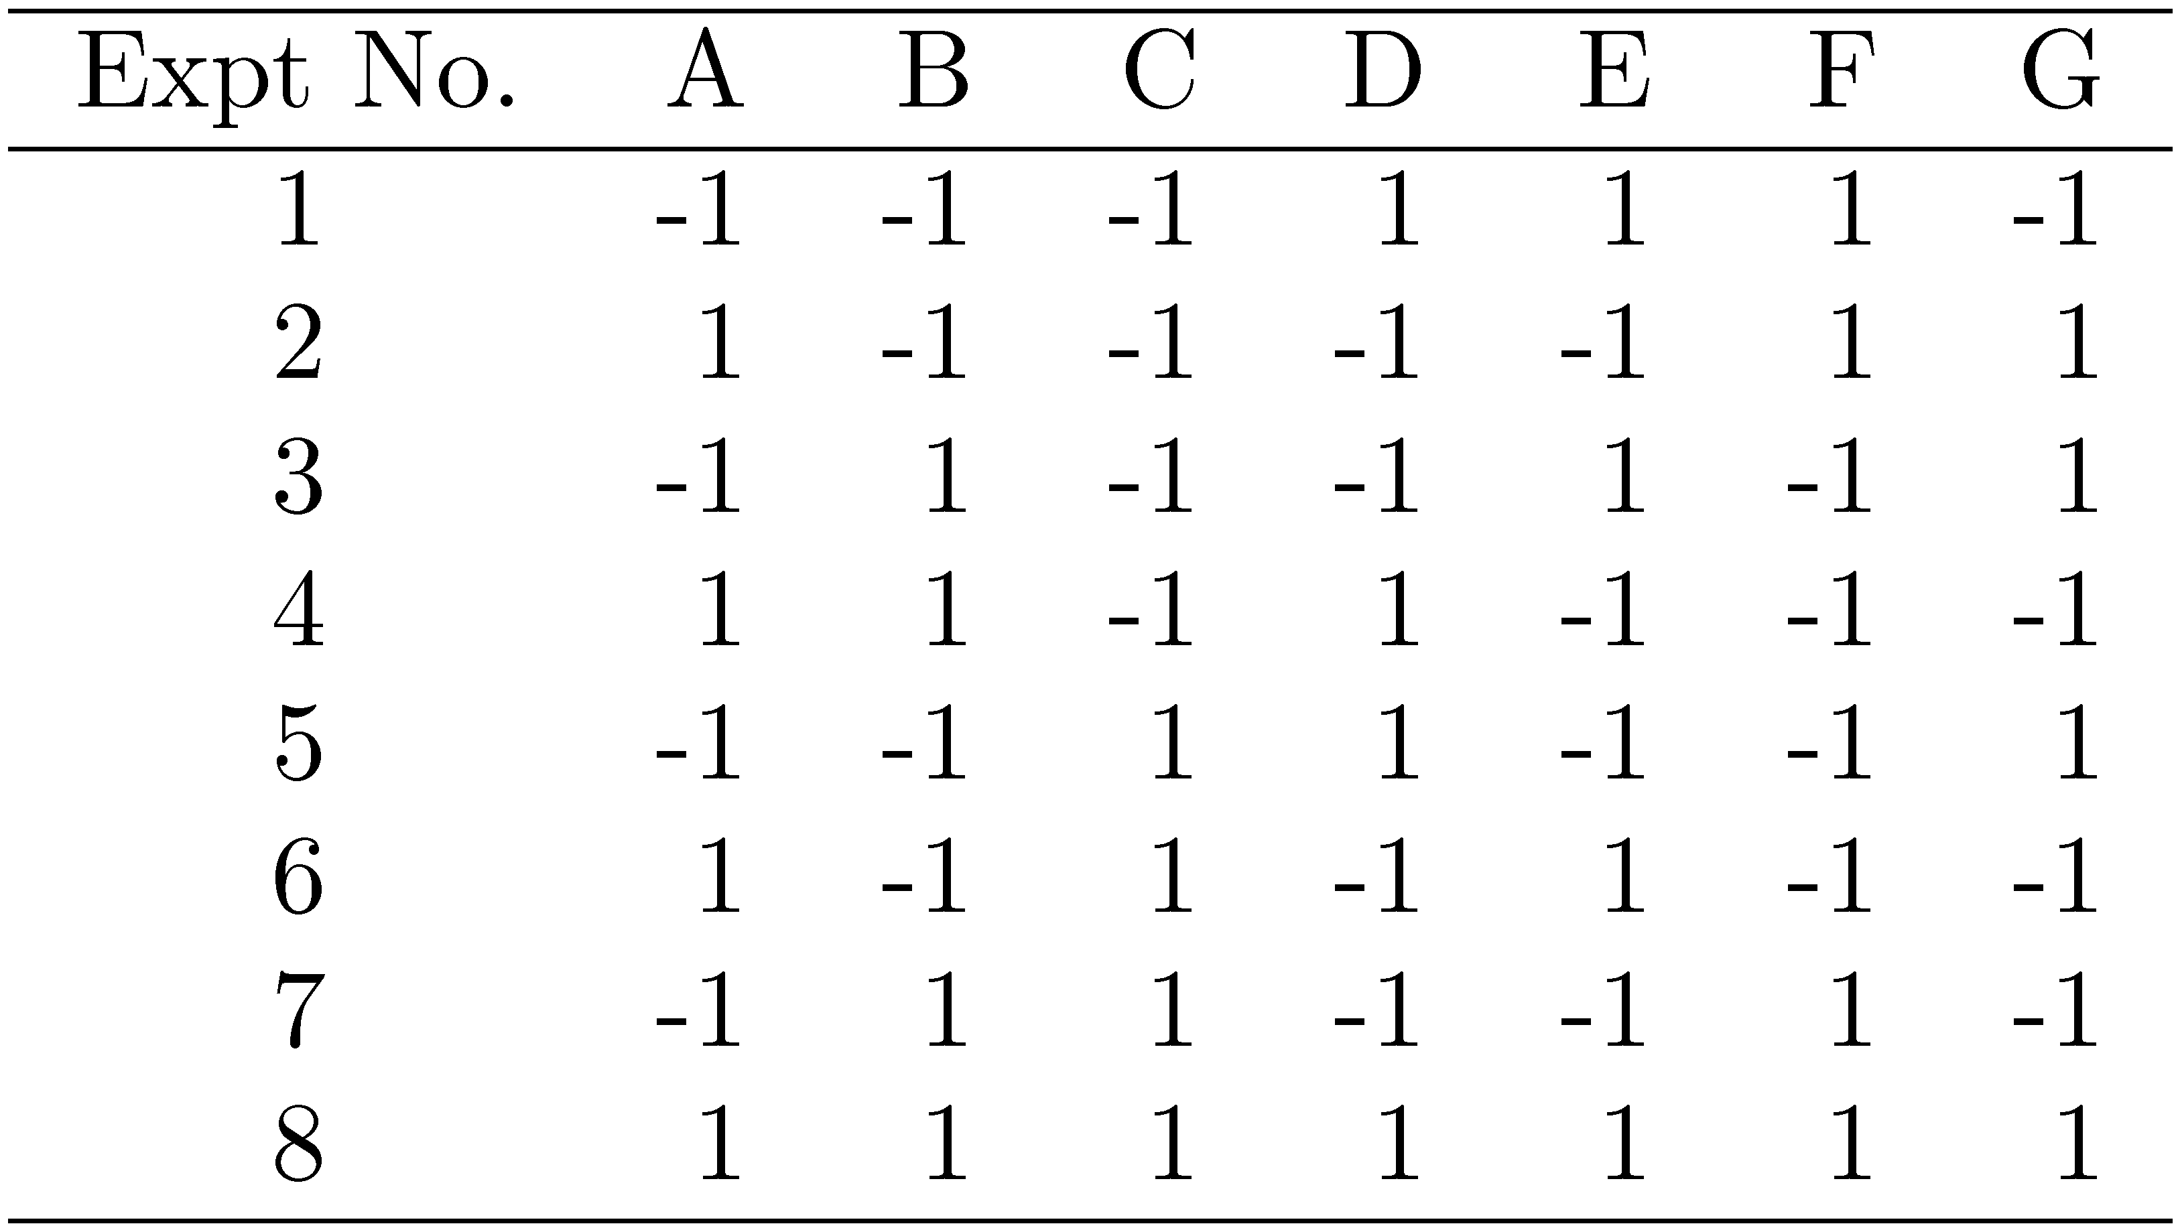
Understanding the sign table
Design Table of 2⁷⁻⁴ generated by
Study 7 factors with only 8 experiments!
What model can we learn from these 8 experiments?

Slide 21
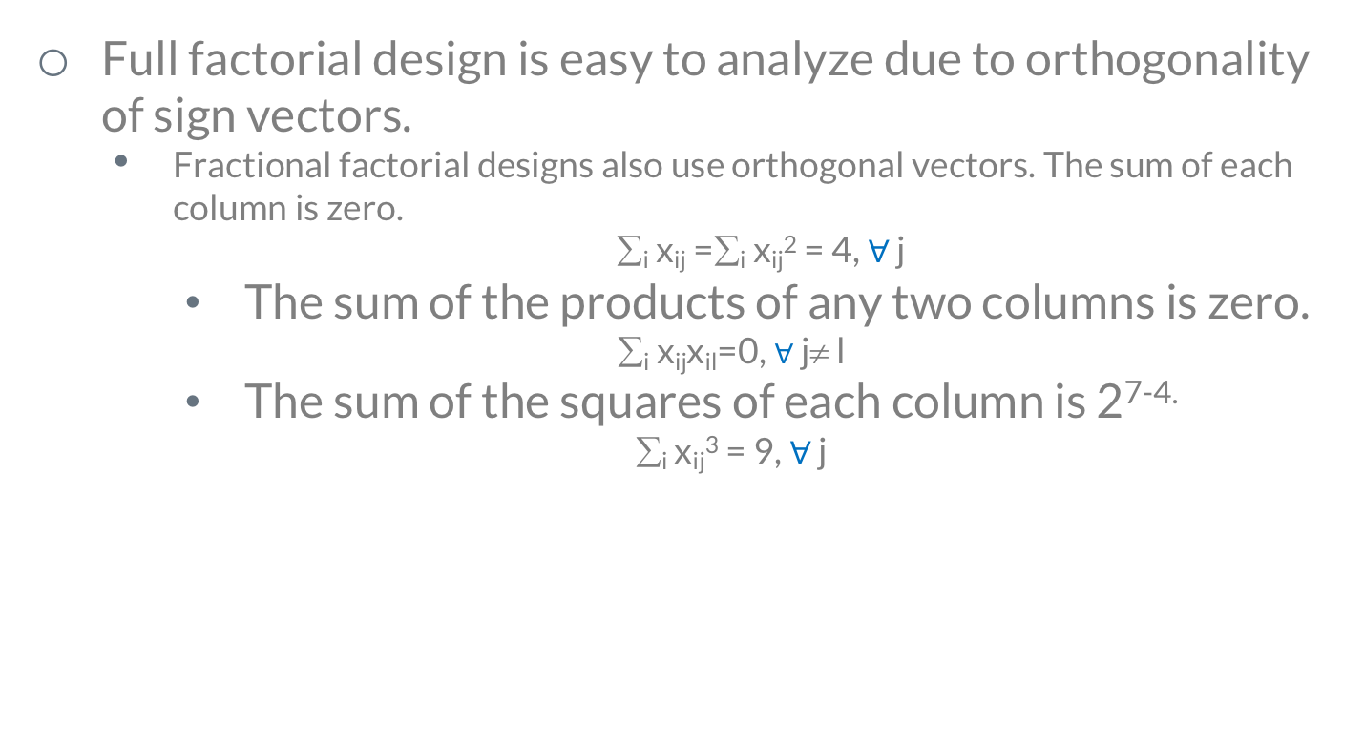
Fractional Design Features
Full factorial design is easy to analyze due to orthogonality of sign vectors.
Fractional factorial designs also use orthogonal vectors. The sum of each column is zero.
∑_{i} x_{ij} =∑_{i} x_{ij}² = 4, $∀$ j
The sum of the products of any two columns is zero.
∑_{i} x_{ij}x_{il}=0, $∀$j≠ l
The sum of the squares of each column is 2^{7-4.}
∑_{i} x_{ij}³ = 9, $∀$ j

Slide 22
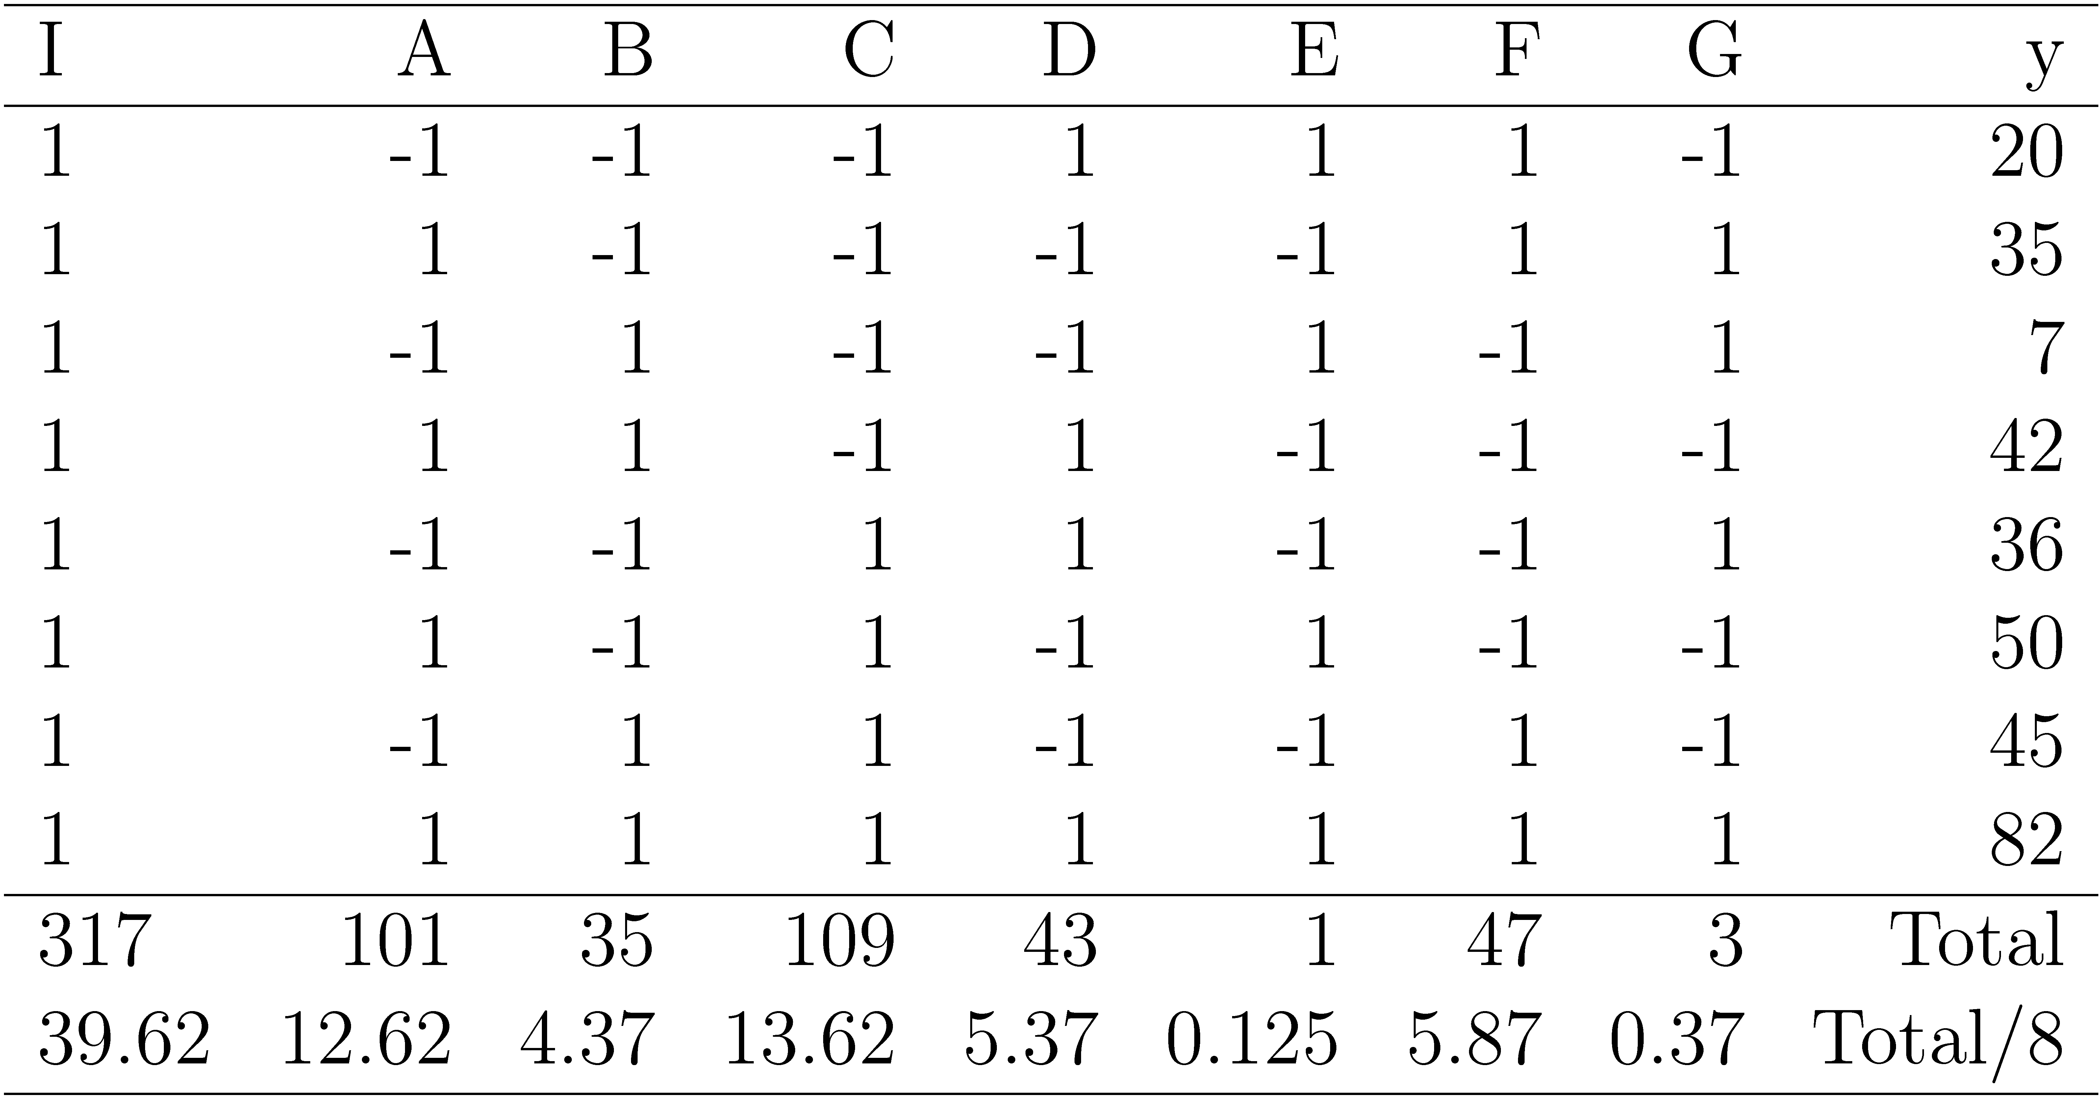
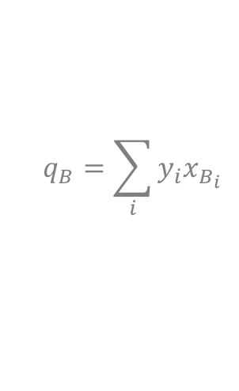

Analysis of Fractional Factorial Designs
Model:
Effects can be computed using inner products.
Good model?
$y=q_{0}+q_{a}x_{a}+q_{B}x_{B}$ $+q_{C}x_{C}$ $+q_{D}x_{D}$ $+q_{E}x_{E}$ $+q_{F}x_{F}$ $+q_{G}x_{G}$
$$q_{A}=\sum_{i}{y_{i}x_{A_{i}}}$$
$$q_{B}=\sum_{i}{y_{i}x_{B_{i}}}$$
Factors A through G explain 37.26%, 4.74%, 43.40%, 6.75%, 0%, 8.06%, and 0.03% of variation, respectively.
Interpretation?

Slide 23
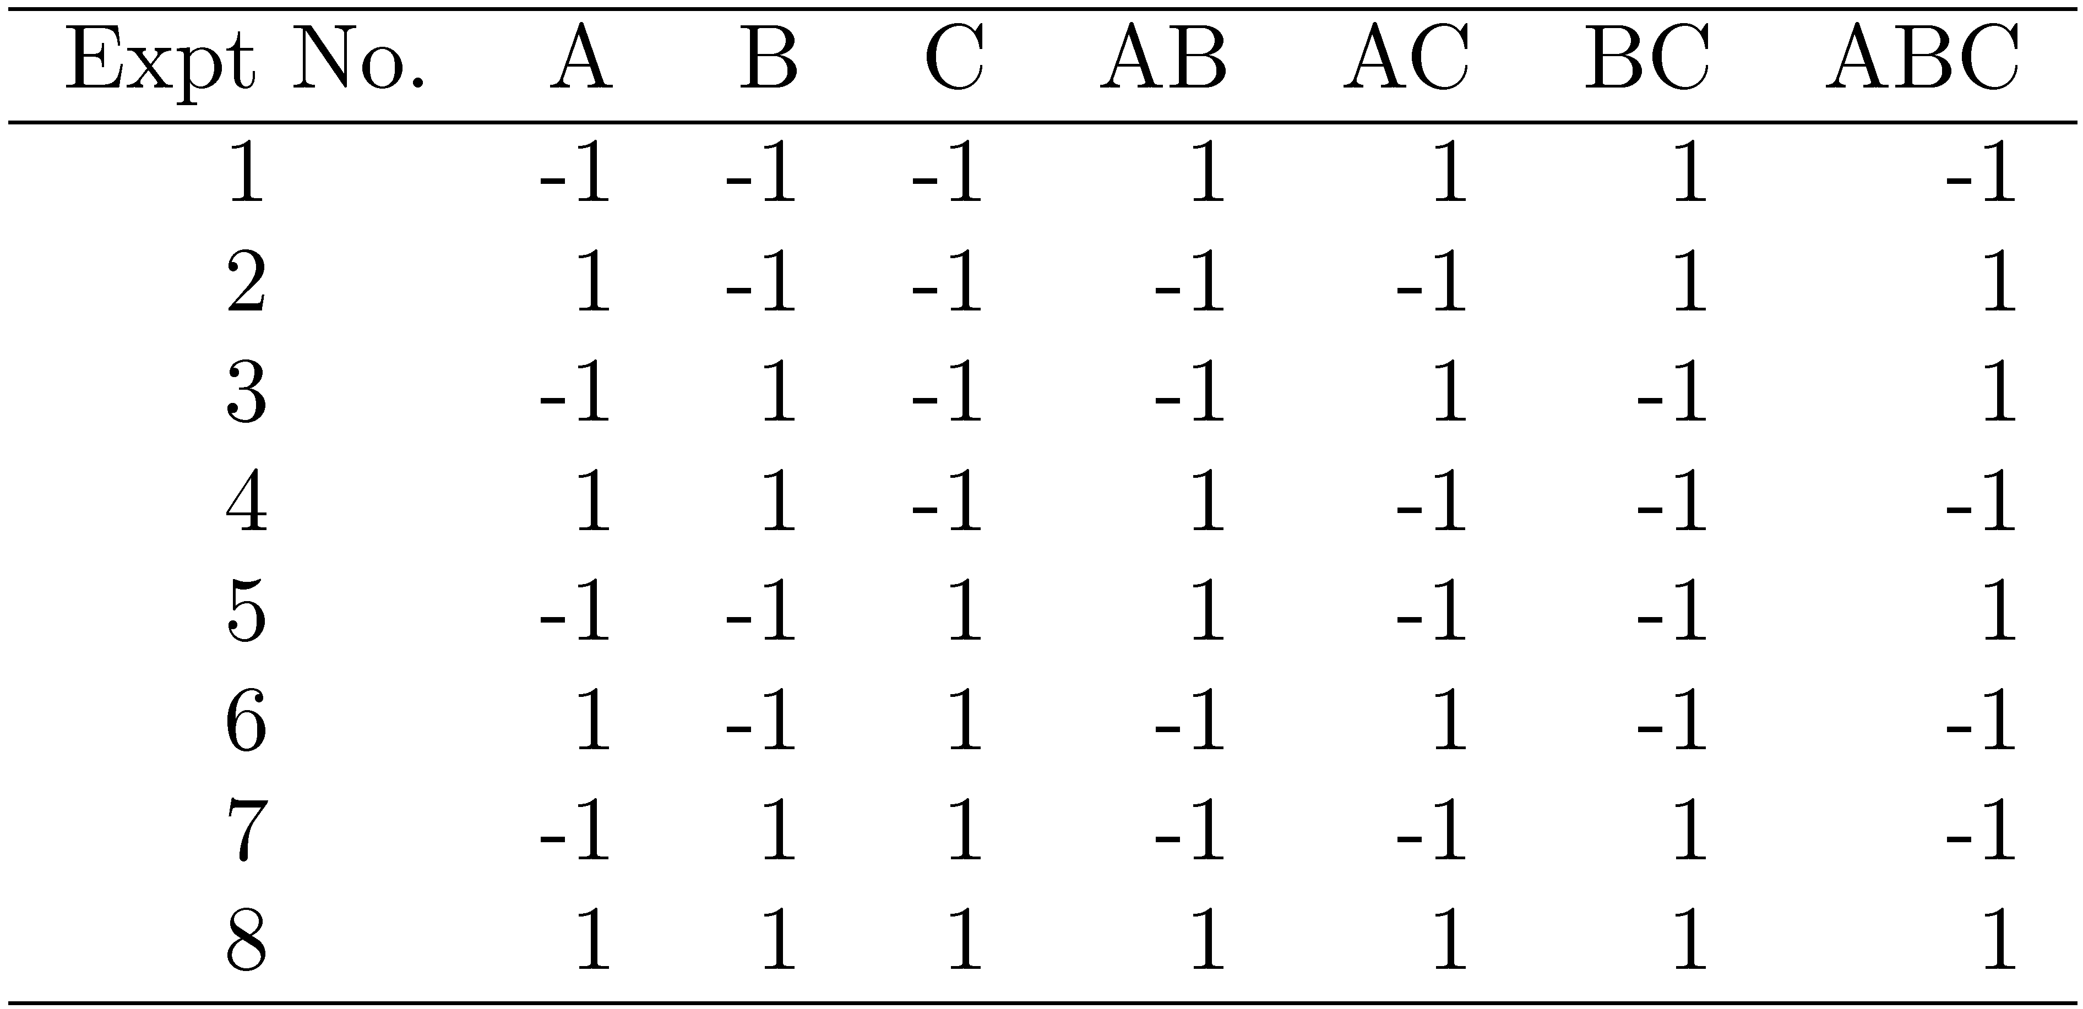
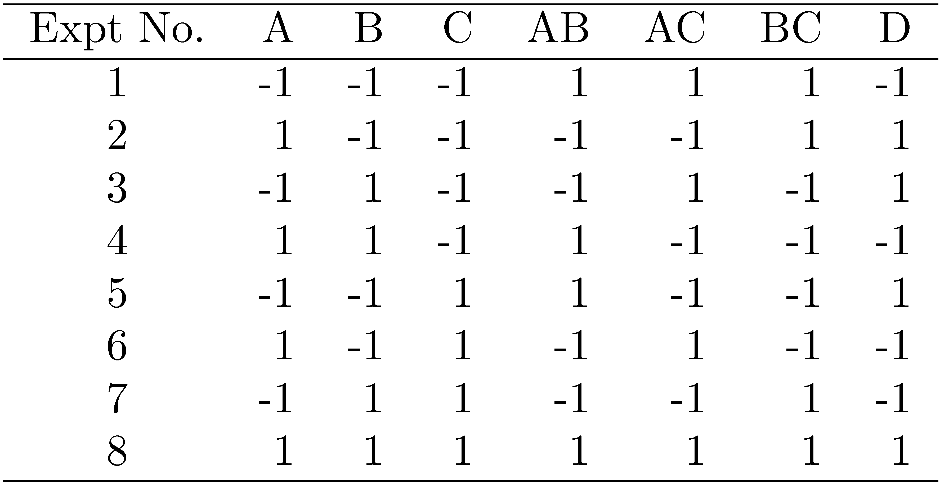
Constructing sign Table for a 2^{k-p} Design
2⁷⁻⁴ Design
Steps:
Prepare a sign table for a full factorial design with k-p factors.
Mark the first column I.
Mark the next k-p columns with the k-p factors.
Of the (2^{k-p}-k-p-1) columns on the right, choose p columns and mark them with the p factors which were not chosen in step 1.
2⁴⁻¹ Design
Which factors to choose for step 3 and step 4?

Slide 24
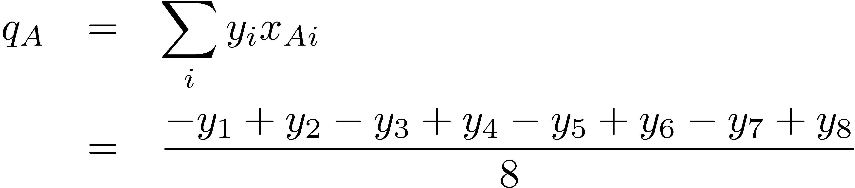
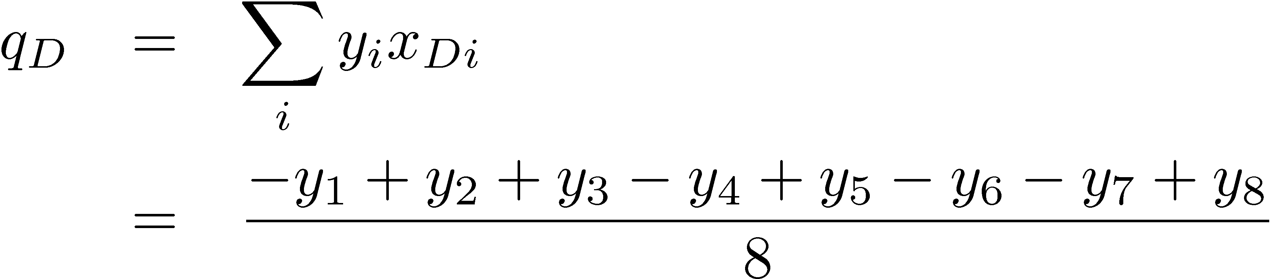
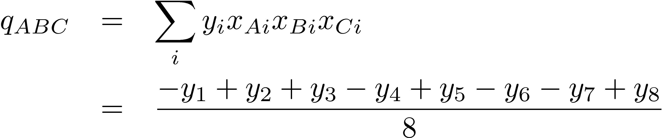

Confounding
Confounding: only the combined influence of two or more effects can be computed.
=
? $Aq_{ABC}=q_{D}C$
ABC is confounded with D, problem?
I =ABCD, meaning?

Slide 25
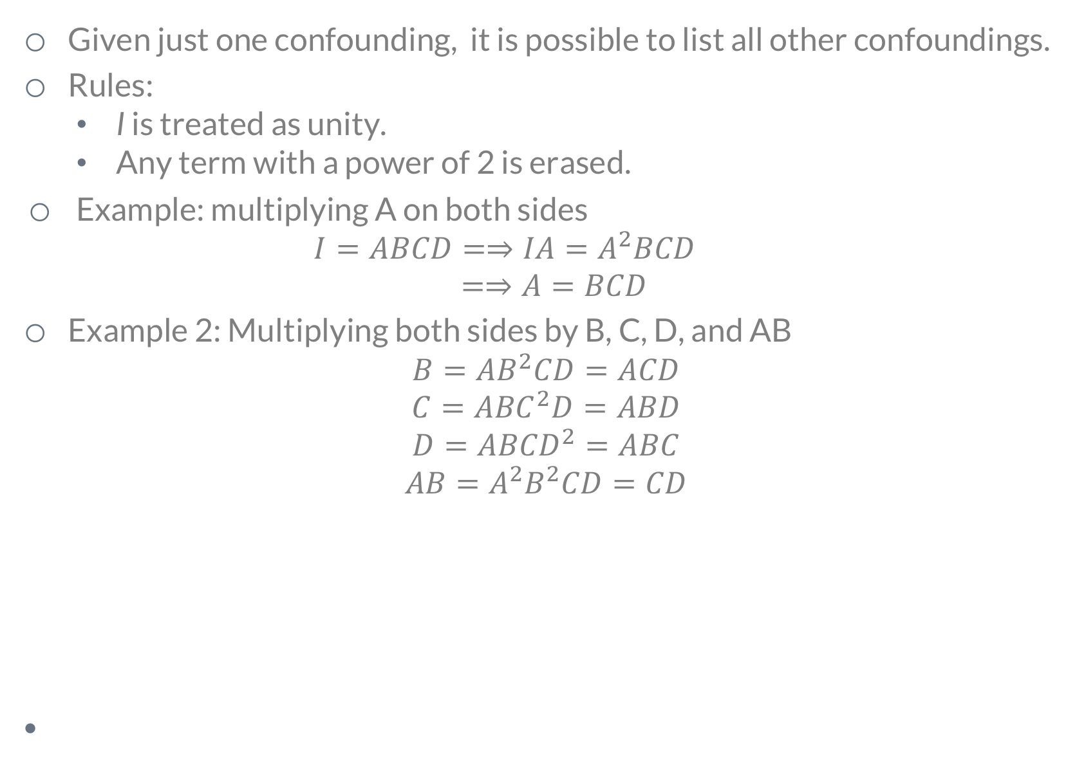
Algebra of Confounding
Given just one confounding, it is possible to list all other confoundings.
Rules:
I is treated as unity.
Any term with a power of 2 is erased.
Example: multiplying A on both sides
$${\begin{aligned}I=ABCD=⇒IA=A^{2}BCD \\ =⇒A=BCD \end{aligned}}_{}$$
Example 2: Multiplying both sides by B, C, D, and AB
$$\begin{aligned}B={AB}^{2}CD=ACD \\ C={ABC}^{2}D=ABD \\ D={ABCD}^{2}=ABC \\ AB={A^{2}B}^{2}CD=CD\end{aligned}$$
In a 2^{k-p} design, 2^{p} effects are confounded together

Slide 26
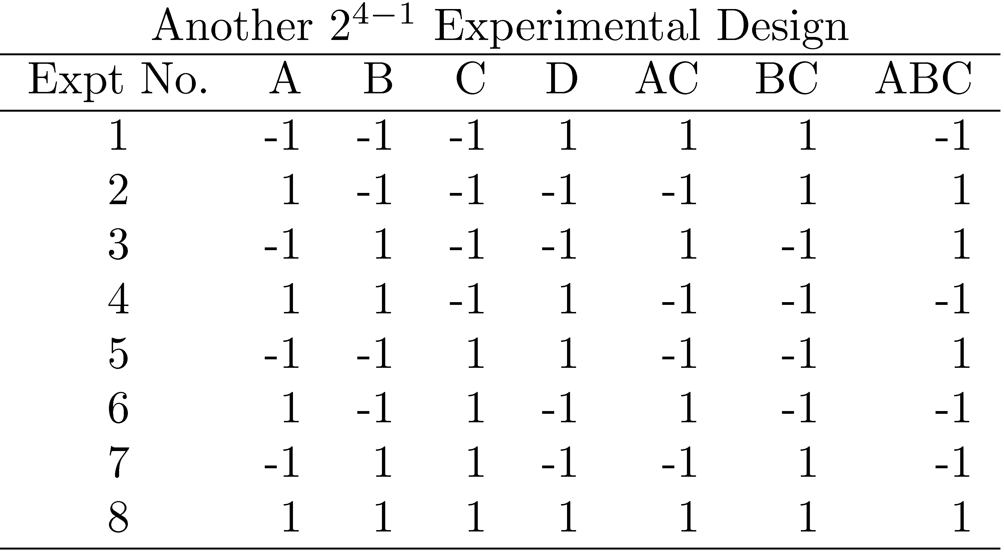


A fractional factorial design is not unique.
2^{p} different designs.
Compare these two designs of 2⁴⁻¹.
Which one is better?
$$I=ABCD$$
$$I=ABC$$

Slide 27
Design Resolution
Order of an effect = Number of terms
Order of ABCD = 4, order of I = 0.
Order of a confounding = Sum of order of two terms
E.g., AB=CDE is of order 5.
Notation: R_{III} = Resolution-III = 2^{k-p}_{III}
Example 1: I=ABCD ⇒ R_{IV} = Resolution-IV = 2⁴⁻¹_{IV}
Example: I = ABD , Resolution?
A design of higher resolution is considered a better design
Resolution of a Design = Minimum of orders of confoundings

Slide 28
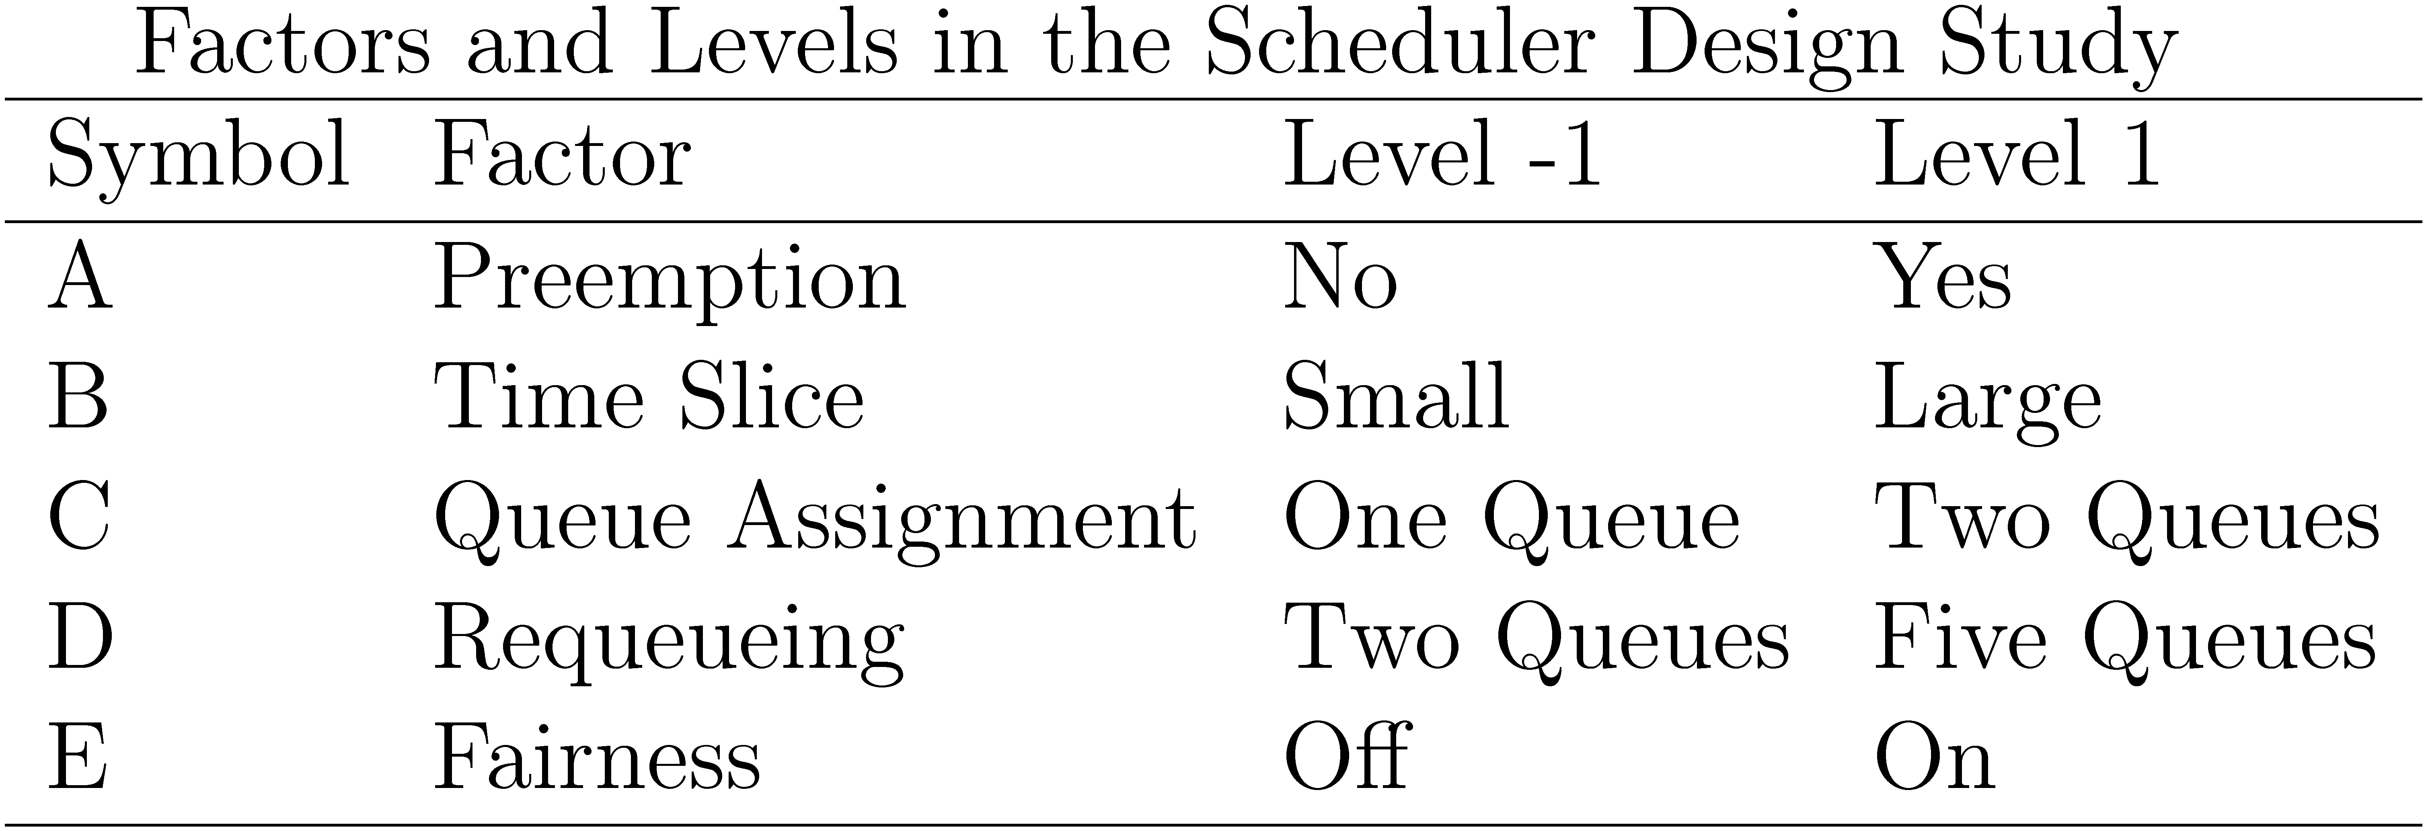
Case Study 19.2: Scheduler Design
Three classes of jobs: word processing, data processing, and background data processing.
Design: 2⁵⁻¹ with I=ABCDE

Slide 29
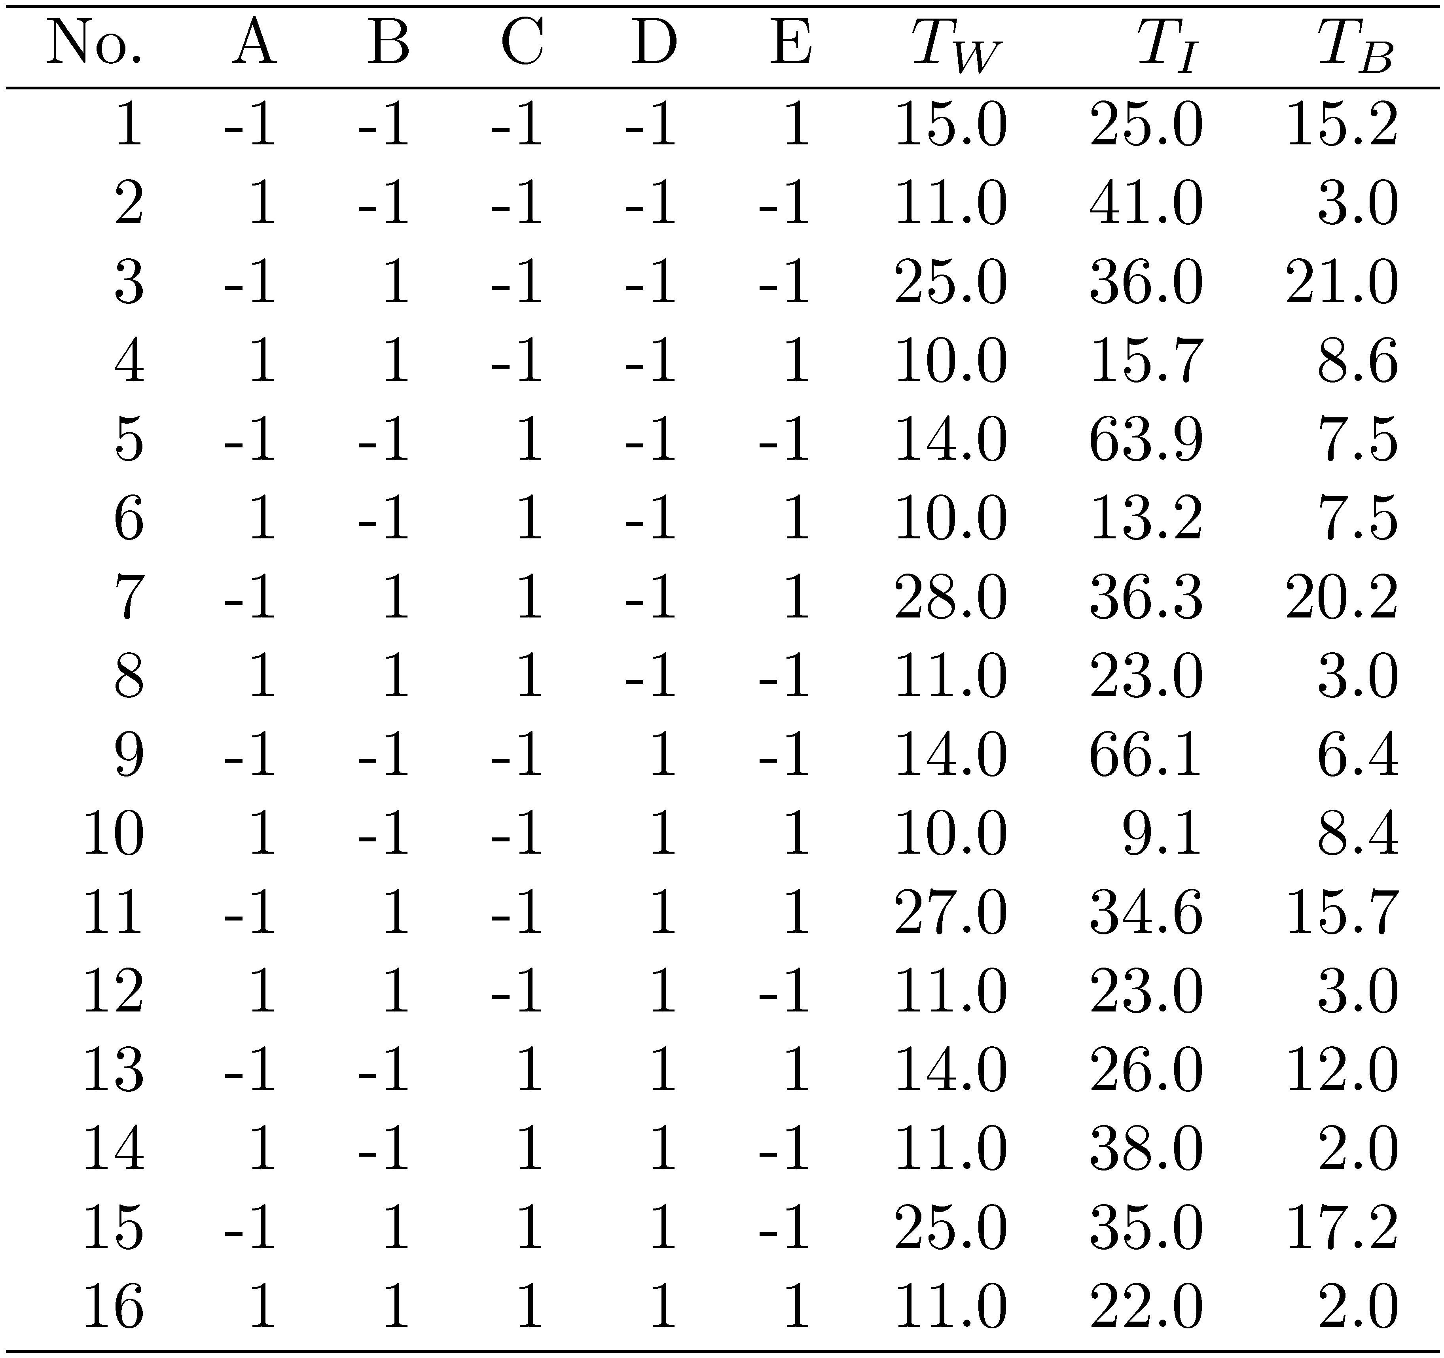
Measured Throughputs
Which experiments to run?, given I=ABCDE
Levels of D?
Levels of E?

Slide 30
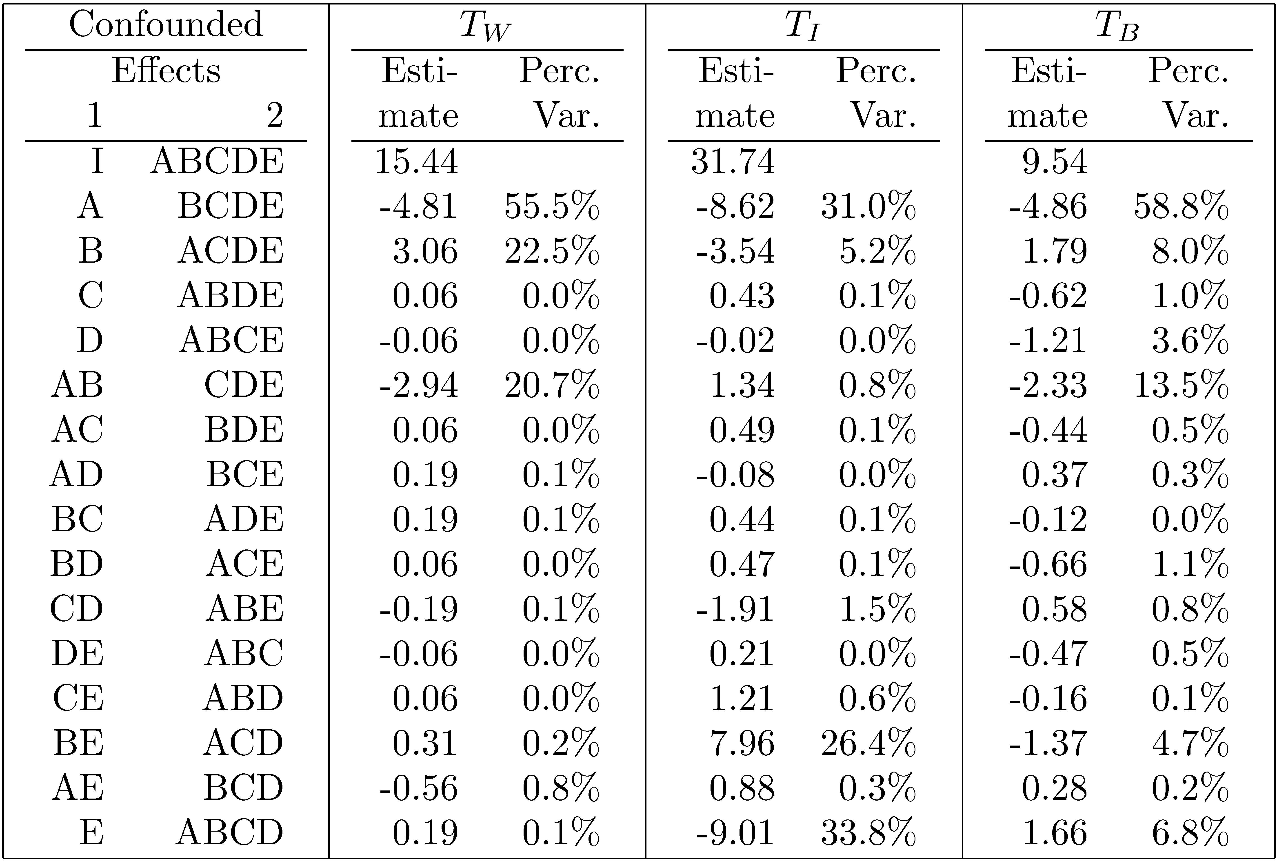
Effects and Variation Explained

Slide 31
Case Study 19.2: Conclusions
For word processing throughput (T_{W}): A (Preemption), B (Time slice), and AB are important.
For interactive jobs: E (Fairness), A (preemption), BE, and B (time slice).
For background jobs: A (Preemption), AB, B (Time slice), E (Fairness).
May use different policies for different classes of workloads.
Factor C (queue assignment) or any of its interaction do not have any significant impact on the throughput.
Factor D (Requiring) is not effective.
Preemption (A) impacts all workloads significantly.
Time slice (B) impacts less than preemption.
Fairness (E) is important for interactive jobs and slightly important for background jobs.

Slide 32
Bonus quiz

Slide 33
Related homework
Exercise 6.4, 7.4

Slide 34

Want big impact?
Use big image.

Slide 35
Thanks!
Any questions?
lydiaychen@ieee.org

Slide 36
Credits
Special thanks to all the people who made and released these awesome resources for free:
Presentation template by SlidesCarnival
Photographs by Unsplash

Slide 37
Presentation design
This presentations uses the following typographies and colors:
Titles: Raleway
Body copy: Lato
You can download the fonts on these pages:
https://www.fontsquirrel.com/fonts/raleway
https://www.fontsquirrel.com/fonts/lato
Dark blue #2185c5
Light blue #7ecefd
Yellow #ff9715
Magenta #f20253
Dark gray #677480
Light gray #97abbc
You don’t need to keep this slide in your presentation. It’s only here to serve you as a design guide if you need to create new slides or download the fonts to edit the presentation in PowerPoint®

Slide 38
SlidesCarnival icons are editable shapes.
This means that you can:
Resize them without losing quality.
Change fill color and opacity.
Change line color, width and style.
Isn’t that nice? :)
Examples:

Slide 39
😉
Now you can use any emoji as an icon!
And of course it resizes without losing quality and you can change the color.
How? Follow Google instructions https://twitter.com/googledocs/status/730087240156643328
✋👆👉👍👤👦👧👨👩👪💃🏃💑❤😂😉😋😒😭👶😸🐟🍒🍔💣📌📖🔨🎃🎈🎨🏈🏰🌏🔌🔑 and many more...

